Slide 1
Mood Capture ( An Emotion Detecting App )
Project By :
Rohan Viraj Deshpande

Slide 2
Base Idea Of the Project :
The Application “Mood Capture” has been developed for detecting certain human emotions like anger, contempt, disgust, fear, happiness, neutral, sadness, and surprise by accepting an image as an input and analyzing the image and then providing the emotion detected in that image.
The image can either be clicked at runtime or it can be selected from the underlying drive.

Slide 3
New System
Proposed System: An UWP application that can be helpful to anyone who has an issue comprehending certain emotions be it due to any no. of reasons, race, creed, comprehension or any other physiological or psychological reasons.
Technology Used : C#, JSON

Slide 4
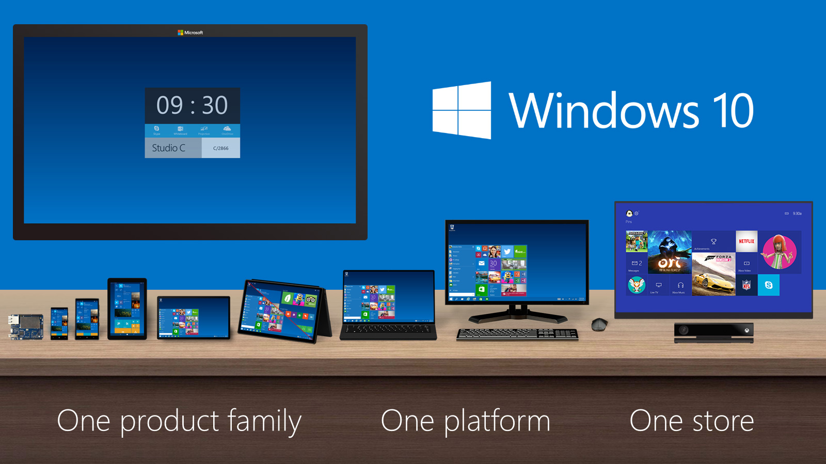
Windows 10 Device Family

Slide 5

Newest Addition to the Above Family : Hololens

Slide 6
Application
Screenshots

Slide 7
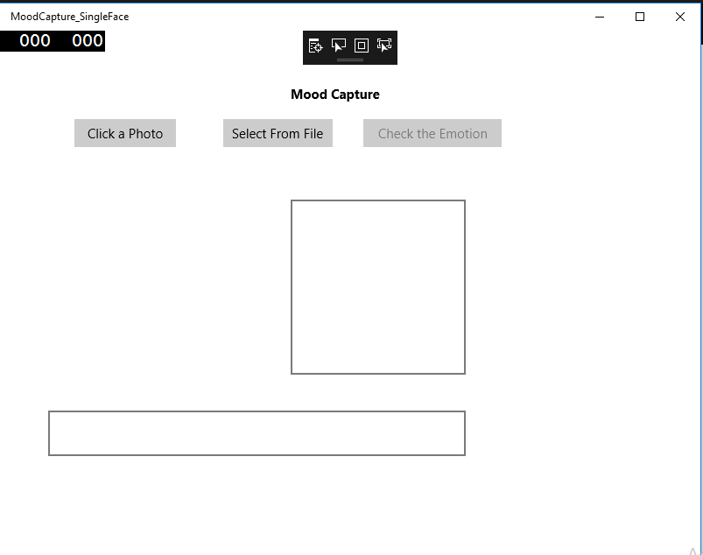
Main Screen

Slide 8
When we decide to Click an image at Runtime.

Slide 9
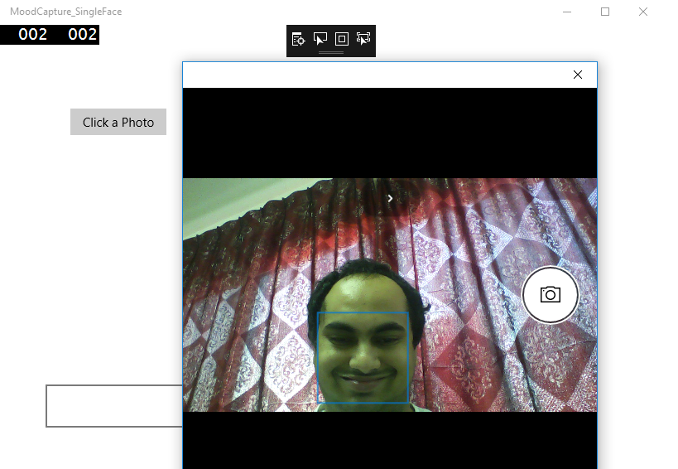
Clicking a Photo Dynamically by Setting Face in the Rectangle

Slide 10
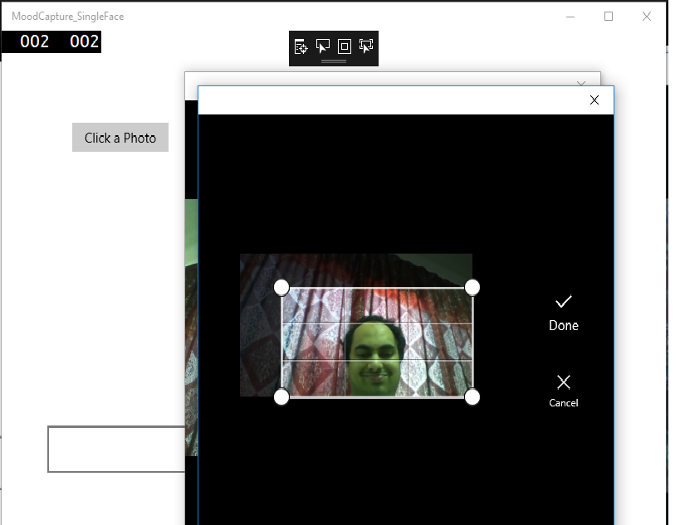
Cropping if necessary

Slide 11
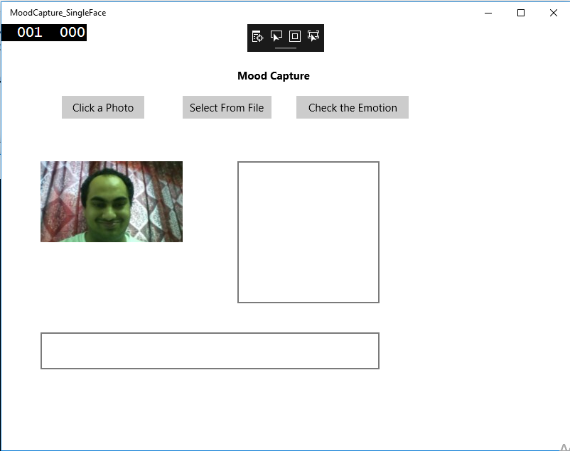
Cropped Image Appears in a ImageBox

Slide 12
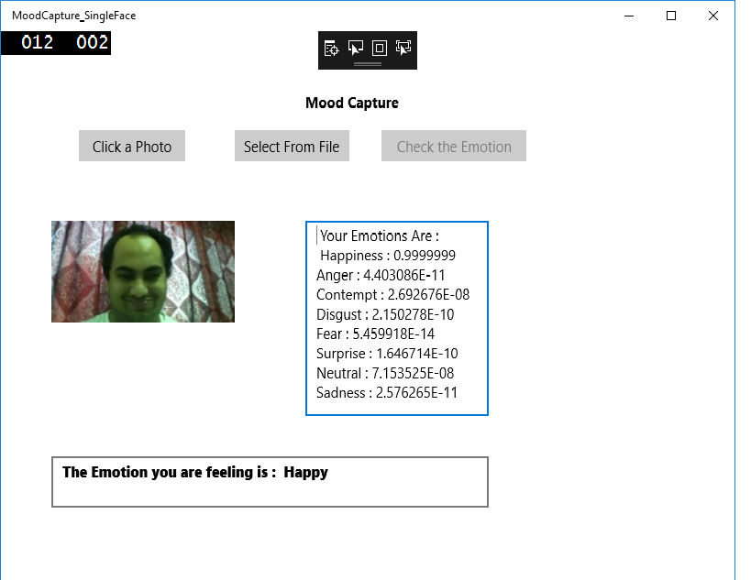
Checking out the Emotion Returned

Slide 13
When we decide to select an Image from the underlying Drive.

Slide 14
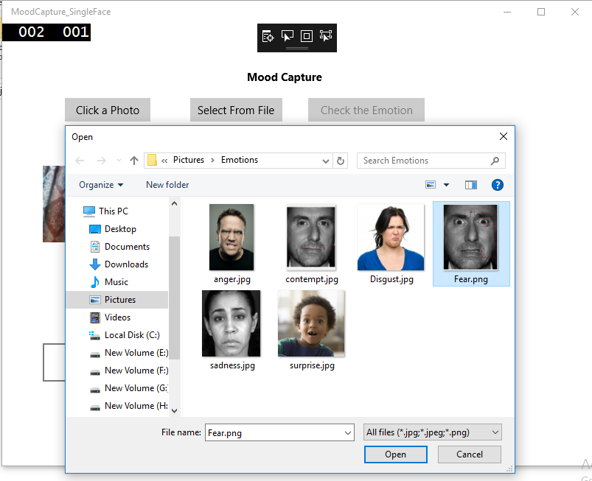
Selecting the Image from a Location

Slide 15
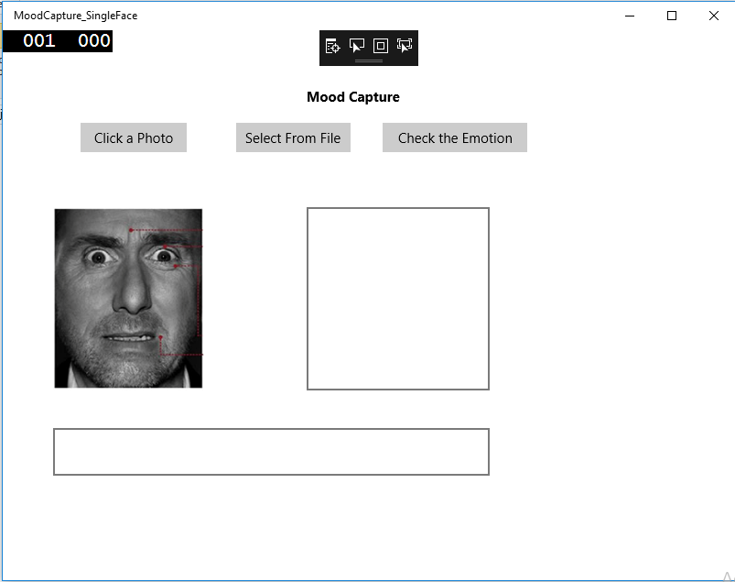
Selected Image Appears in a ImageBox

Slide 16
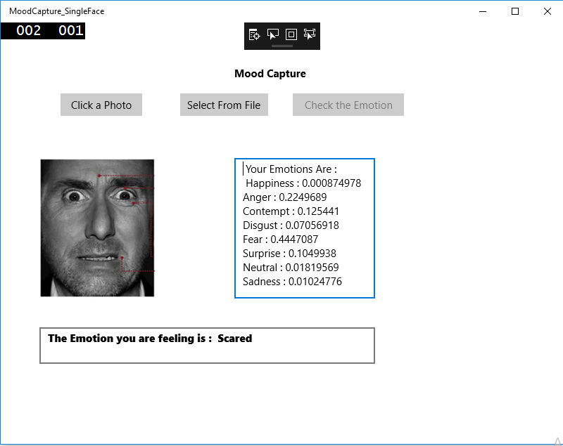
Emotion Returned by the API

Slide 17
Testing Phase :
Exception Screenshots

Slide 18
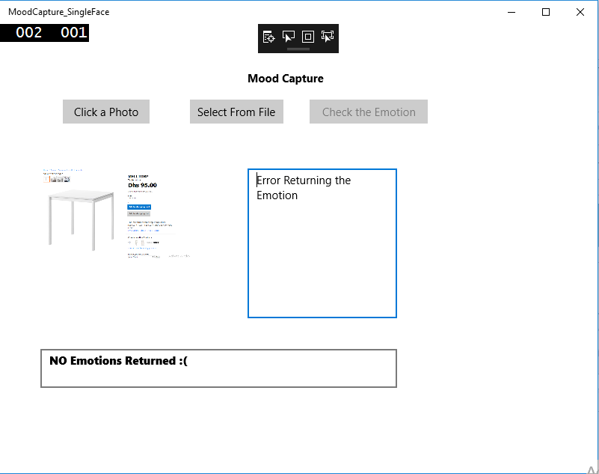
Invalid Image Content

Slide 19
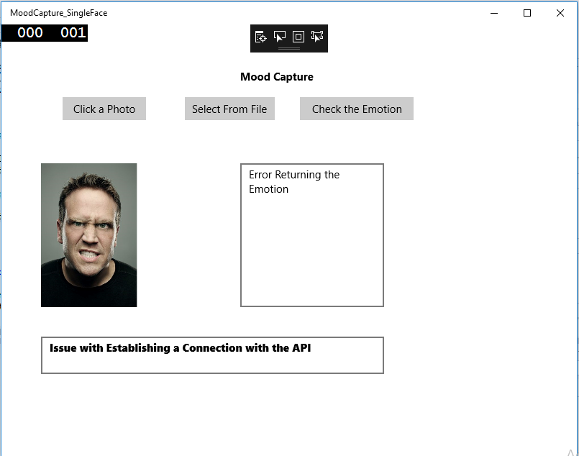
Unable to connect to the API

Slide 20
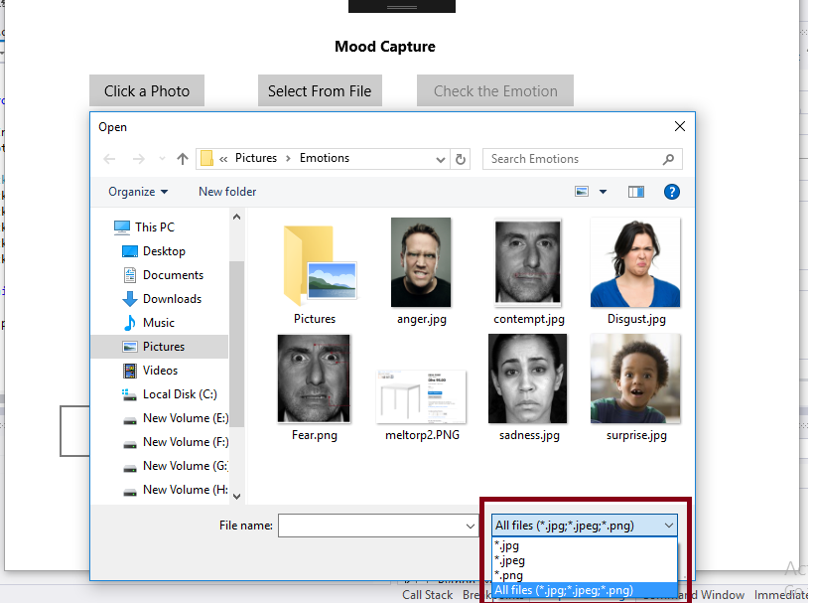
Allowed File Types

Slide 21
Limitations
As it is a Universal Windows Platform based Application, a few limitations persist:
Users will need to have Windows 10 based Devices or they will need the UWP Bridge
The application will need Internet Connectivity.

Slide 22
Future Enhancements
Will add Speech Recognition and Visual Learning for Holo Lens
Will add the ability be able to tell if the face is of a celebrity or any pre-configured face

Slide 23
References Used
YouTube Tutorials
https://msdn.microsoft.com
http://www.google.com/
http://tutorialspoint.com/

